Slide 1

eVOTING SYSTEM
SRM INSTITUTE OF SCIENCE AND TECHNOLOGY
FACULTY OF ENGINEERING AND TECHNOLOGY
DEPARTMENT OF NETWORKING AND COMMUNICATIONS
21CSC205P DATABASE MANAGEMENT SYSTEM

Slide 2
INDEX
INTRODUCTION
PROBLEM STATEMENT
ABSTRACT
MIND MAP
ER DIAGRAM
REFERNCES

Slide 3
INTRODUCTION
eVoting systems revolutionize the traditional voting process by leveraging digital technology to enable citizens to cast their votes online.
This systems aim to enhance accessibility, efficiency, and accuracy in elections, and analyze the different aspect of result.
Exploring the various facets of e-voting is crucial to understanding its impact on democratic processes and ensuring a trustworthy electoral system.

Slide 4
PROBLEM STATEMENT
Ballot Manipulation Concerns: Worries about ballot manipulation highlight the need for robust safeguards ensuring the authenticity and accuracy of election results.
Accessibility : Ensuring accessibility, especially for voters with disabilities, remains a pivotal challenge in implementing e-voting systems.
Analysis : Analysis of election result to understand the vote bank of every candidate.
Standardization Issues: The absence of universal standards leads to inconsistencies and vulnerabilities across e-voting implementations, impacting reliability.

Slide 5
ABSTRACT
Examining the landscape of electronic voting systems, this abstract delves into the potential threats jeopardizing the security and reliability of democratic processes. It dissects various vulnerabilities and explores strategies to fortify the integrity of the voting process, ensuring the accuracy and authenticity of election results. By addressing concerns related to electronic ballot manipulation, the abstract aims to instill and sustain public trust in e-voting systems.

Slide 6
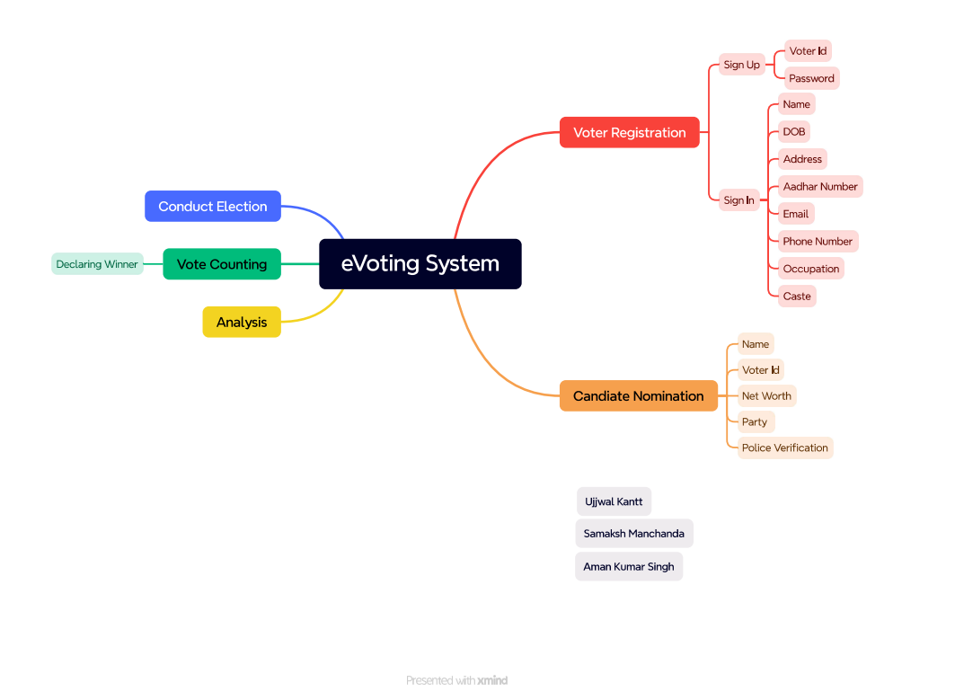
MIND MAP

Slide 7
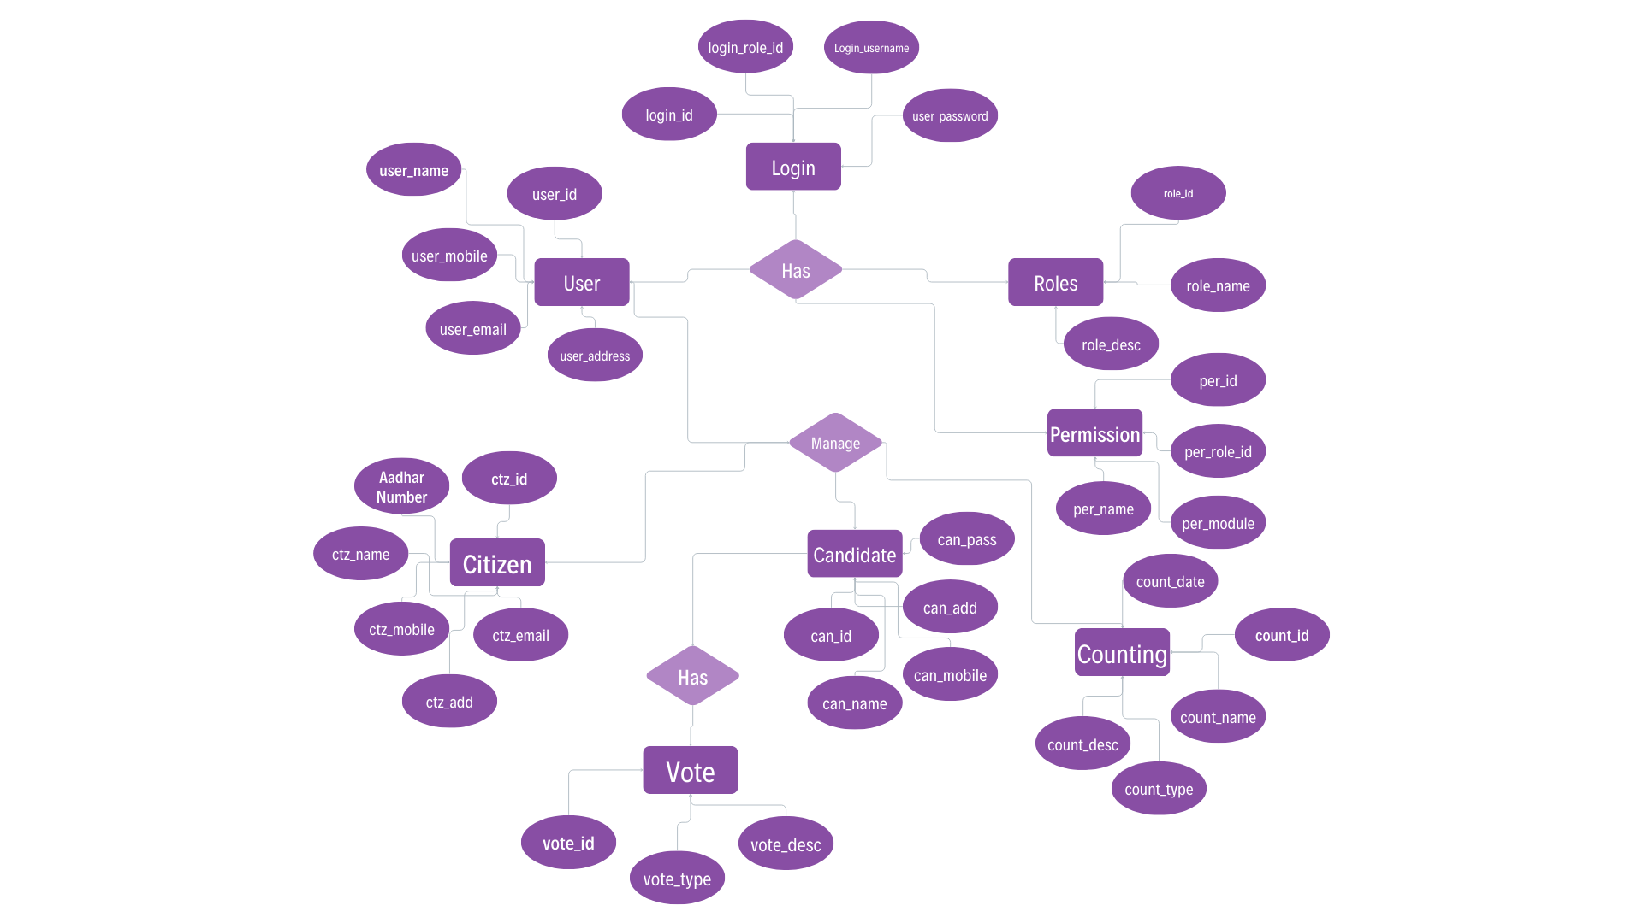
ER-DIAGRAM

Slide 8
REFERNCES
www.geeksforgeeks.org
www.coursera.org
www.udacity.com
www.cse.iitb.ac.in

